Slide 1
Power Platform Introduction
By
Microsoft MVPs
Power Platform Classmates

Slide 2
Agenda
Introductions
01
Digital Transformation Stories
02
Power Platform Overview
03
Dataverse
04
Dynamics First Party Apps
05
Q&A
06

Slide 3
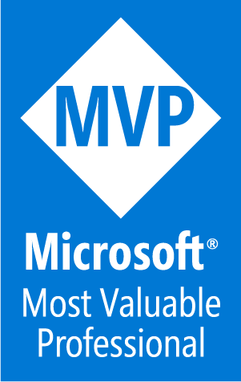






Pavan Mani Deep Yaragani
Pavanmanideep@hotmail.com
LinkedIn.com/in/pavanmanideep/
https://ecellorscrm.com
@ecellorsCRM
YouTube.com/ecellorsCRM
Connect with me!

Slide 4


Interest check

Slide 5
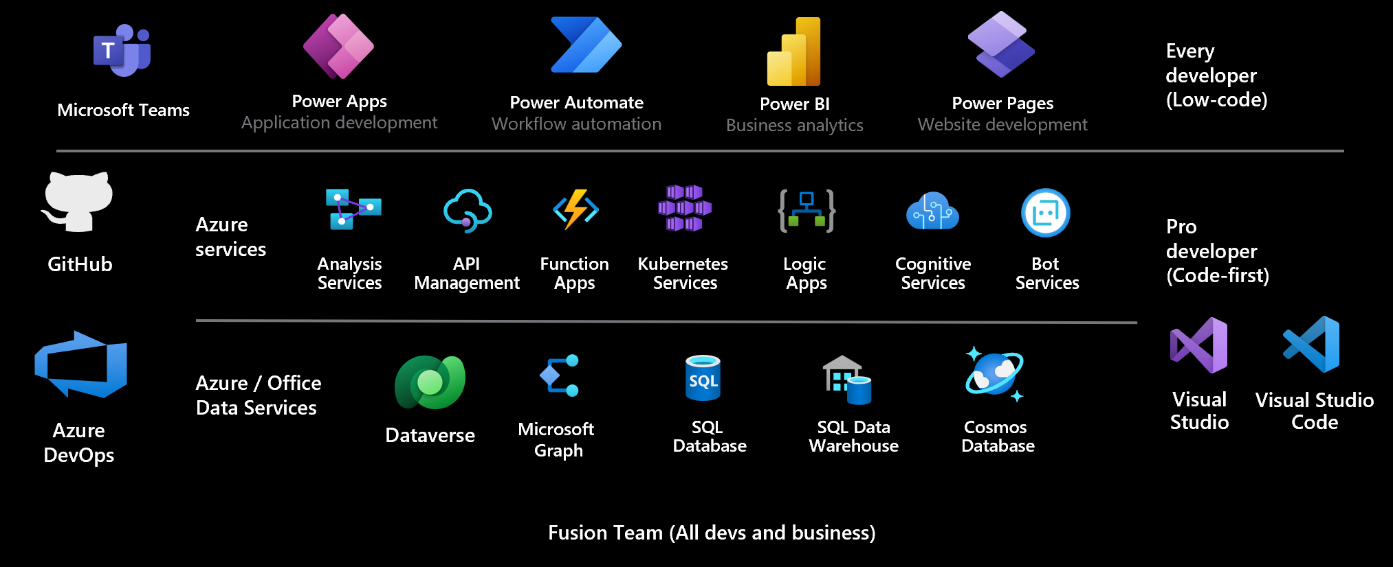

Slide 6
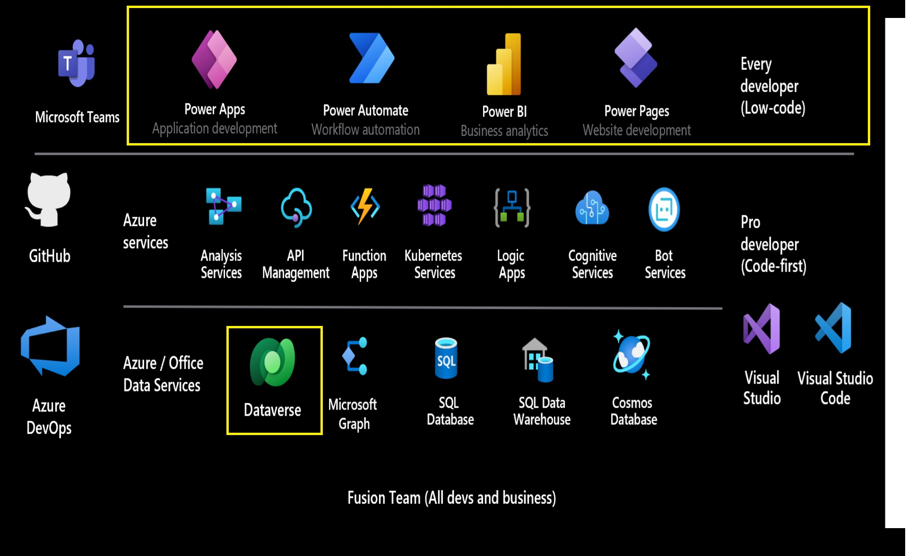

Slide 7
Dataverse

Slide 8





Microsoft Dataverse
Power Apps
Power Automate
Power BI
Dataverse
Copilot Studio
Notes:
Dataverse lets you securely store and manage data that's used by business applications. Data within Dataverse is stored within a set of tables. A table is a set of rows (formerly referred to as records) and columns (formerly referred to as fields/attributes). Each column in the table is designed to store a certain type of data, for example, name, age, salary, and so on. Dataverse includes a base set of standard tables that cover typical scenarios, but you can also create custom tables specific to your organization and populate them with data. App makers can then use Power Apps to build rich applications that use this data.
Source: App in a Day Trainer – aka.ms/appinadaytrainer

Slide 9
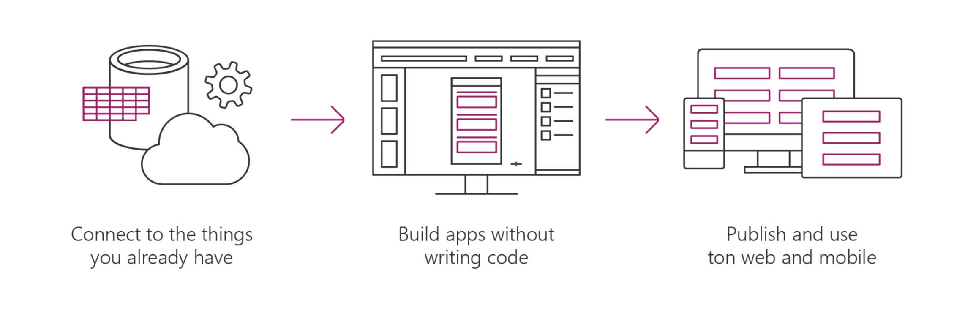

Dataverse (Dataverse)
Dataverse
Allows you to securely store and manage the data used in apps
Dataverse is how Power Apps, Office, and the Dynamics suite of products integrate with a single system of record for business data
Store data in standard and custom tables with rich metadata
Build Power Apps apps and automate workflows against the data stored in Dataverse
Add business rules & validation Define role-based security
Notes:
Historically speaking you may hear Dataverse referred to as CDS, Common Data Service or even XRM. It’s a relational database that you can customize and use with Power Apps and Power Automate.
Source: App in a Day Trainer – aka.ms/appinadaytrainer

Slide 10
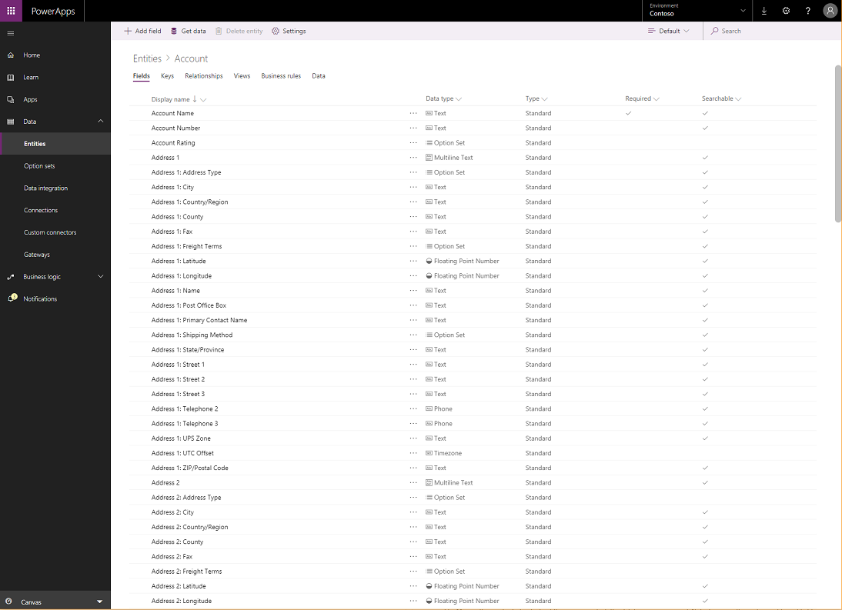
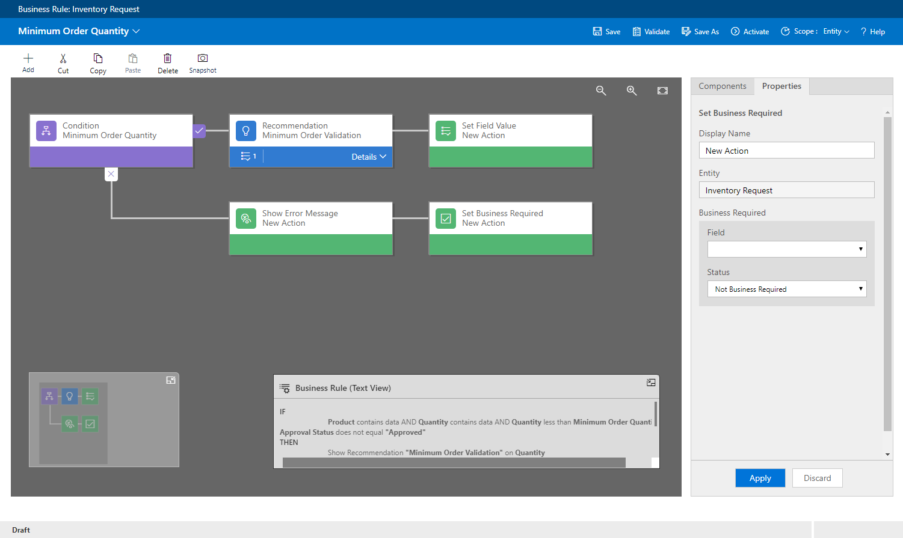
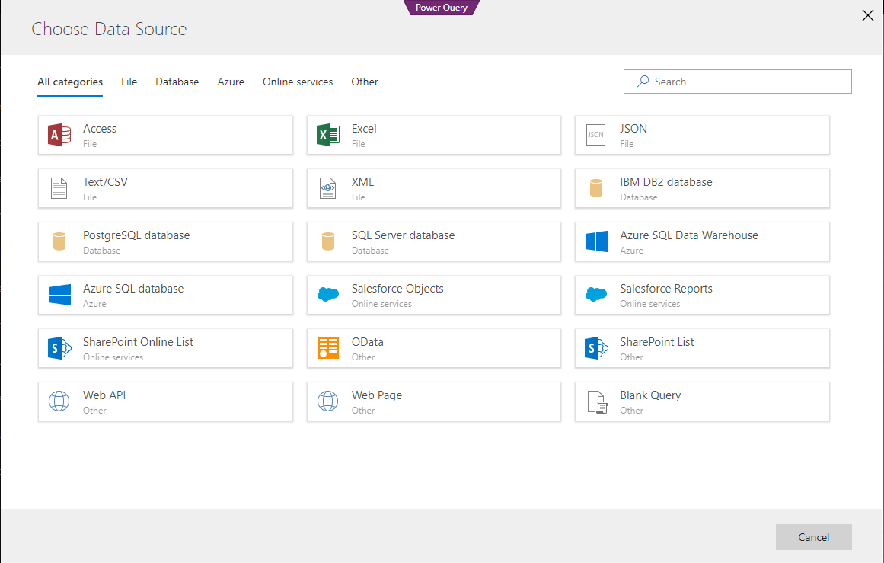
Dataverse
Standard tables that represent commonly used concepts and activities across a variety of business & app domains
Ability to extend the standard entities by adding custom columns and relationships
Add custom tables to support your scenario and application
Create calculated and roll up fields to provide consistent calculations across apps
Define business rules and validation to ensure data quality
Easily import and synchronize your data using Power Query
Sophisticated security model providing row level security and even models hierarchies.
Production ready pro developers use APIs allowing Dataverse access from any pro-dev application
Notes:
Effortless Dynamics 365, Office 365, and Azure integration, augmented with data from industry partners
Extend data and processes to external and anonymous users with Power Apps Portals
Source: App in a Day Trainer – aka.ms/appinadaytrainer

Slide 11
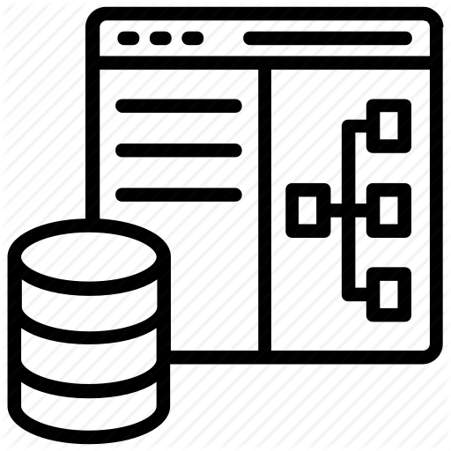
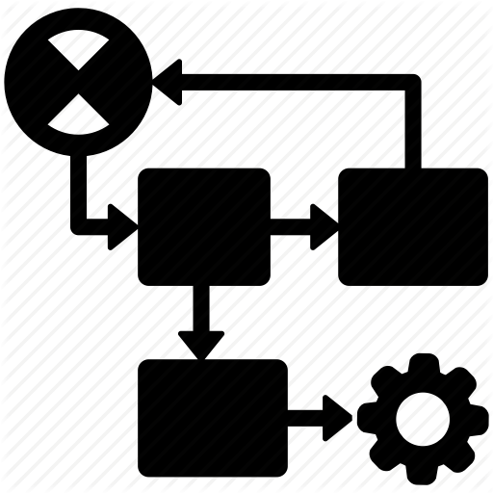







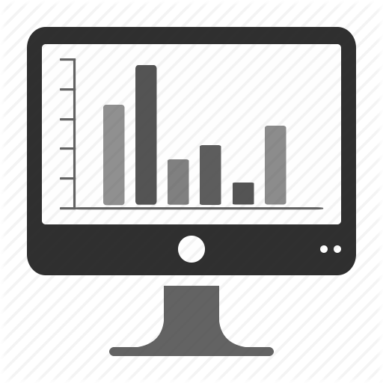












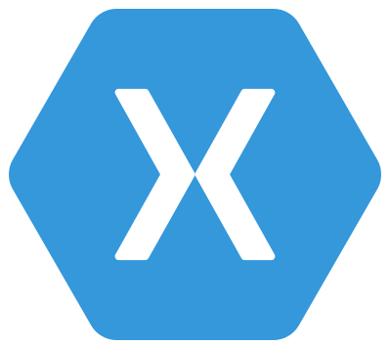

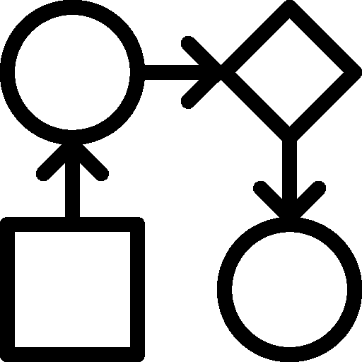
Microsoft Dataverse: What’s in the box
Integration
Storage
Relational
databases
Eventing
Data
Catalog
and discovery
Files and
blobs
Logic
Log files
Webhooks
Jobs
Modelling
Security
Reporting
Semi-structured
data
Business
Rules
API
Calculated &
Rollup fields
Authentication
Duplicate
Detection
Data
validation
Search and
Find data
Authorization
Plugins
Data export
Common Data
Model
Auditing
Workflows
Data lake
Notes:
Source Ignite the Tour deck
Updated Icons
Microsoft Learn: https://docs.microsoft.com/en-us/learn/modules/introduction-common-data-service/2-overview?WT.mc_id=BA-MVP-5003431

Slide 12





Microsoft Power Platform
One low-code platform that spans Microsoft 365, Dynamics 365, Azure and standalone applications
Power Apps
Application development
Power BI
Business analytics
Power Automate
Workflow automation
Copilot Studio
Intelligent virtual agents
Microsoft Dataverse
Data connectors
AI Builder

Slide 13
Unifying to one high-productivity application platform
Unifying to one high-productivity application platform
Dynamics 365 applications
Customized Office 365 (e.g., SharePoint form)
Standalone model-driven apps
Standalone canvas apps
ISV apps
Power Apps
App Module Designer
Form Designer
View Designer
Dashboard Designer
Canvas Studio
Solution Explorer (advanced)
Power Automate (workflow and business processes)
Sharing and Security
Dataverse
Table/entity Designer
Dynamics 365 data is natively on the platform – no integration required
Enterprise-grade Application Lifecycle Management
Server-side business logic for validation, defaulting, calculated fields and more
Notes:
Dataverse is at the foundation of each of these to help build upon.
Source: App in a Day Trainer – aka.ms/appinadaytrainer

Slide 14

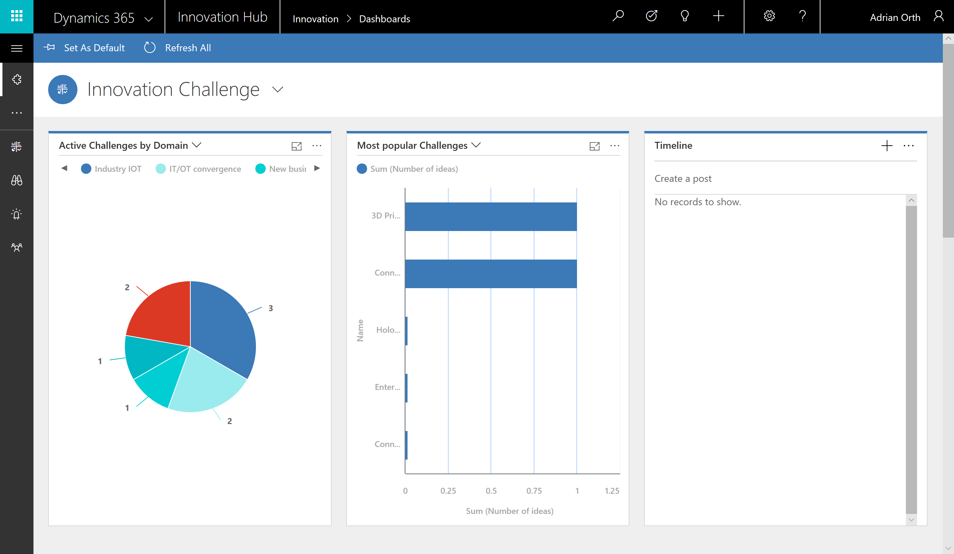

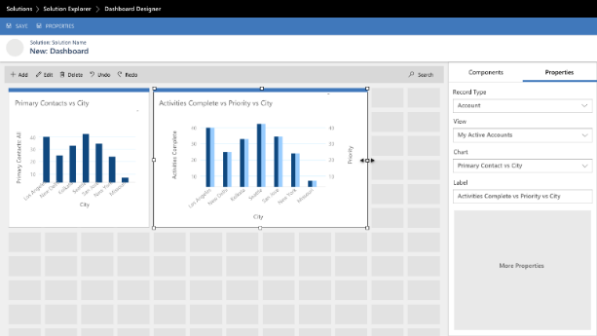
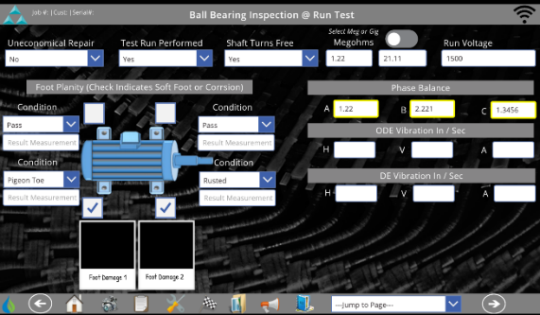
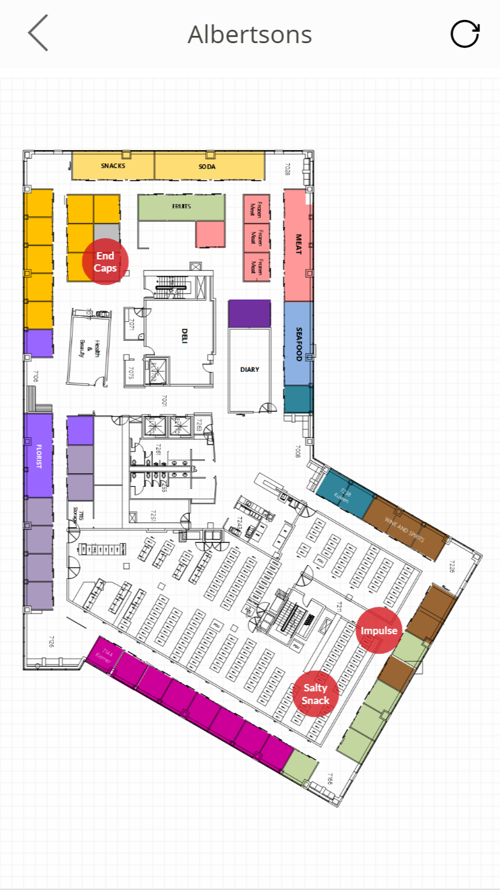
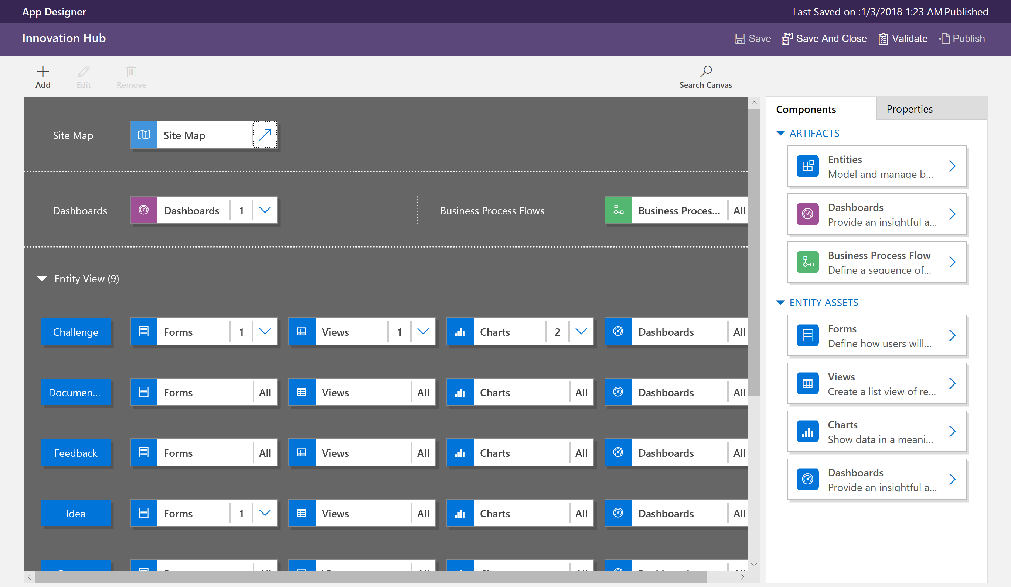
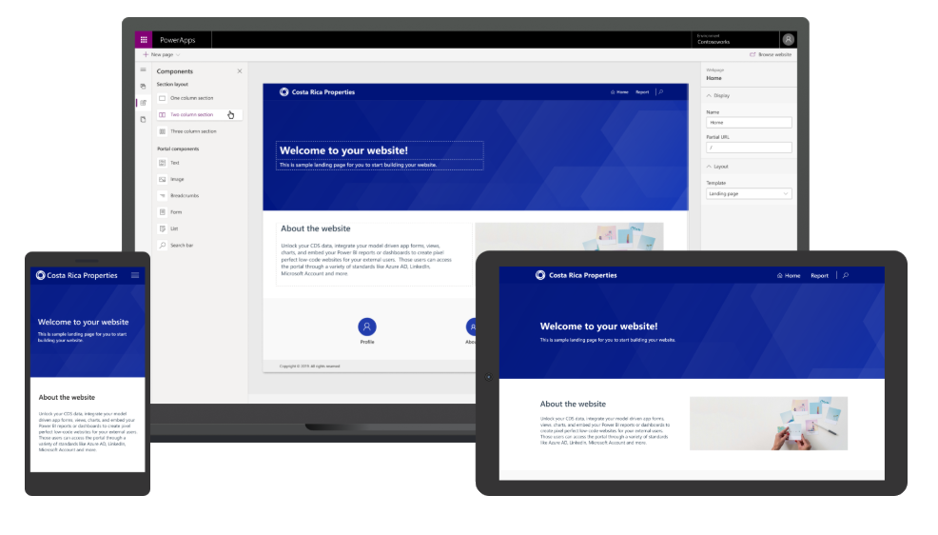
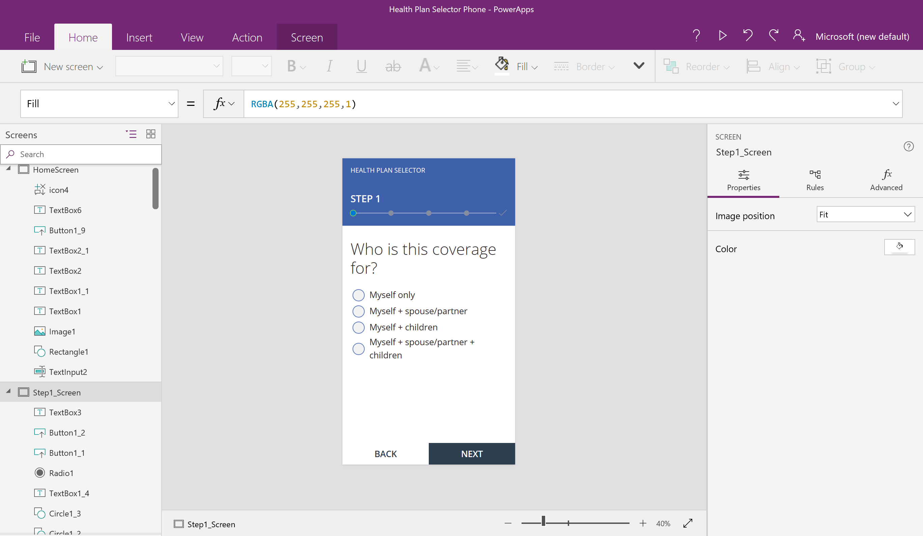
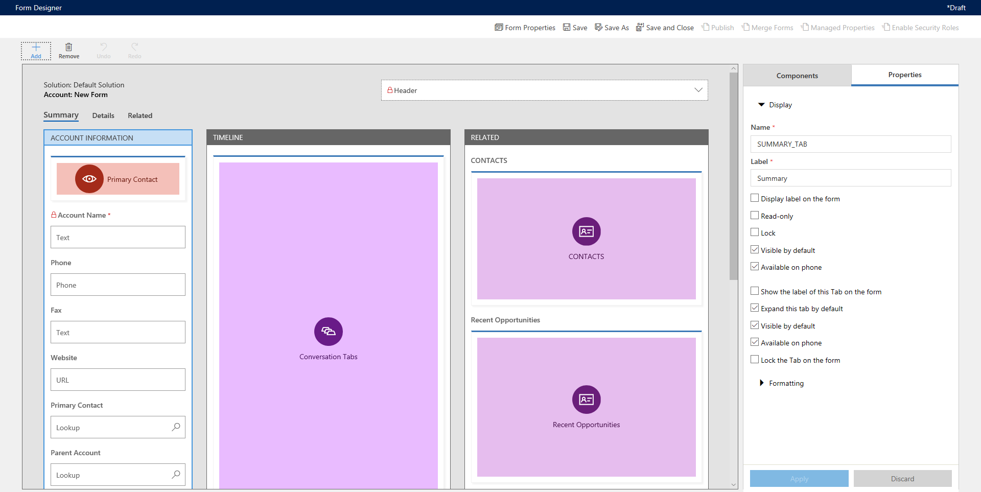
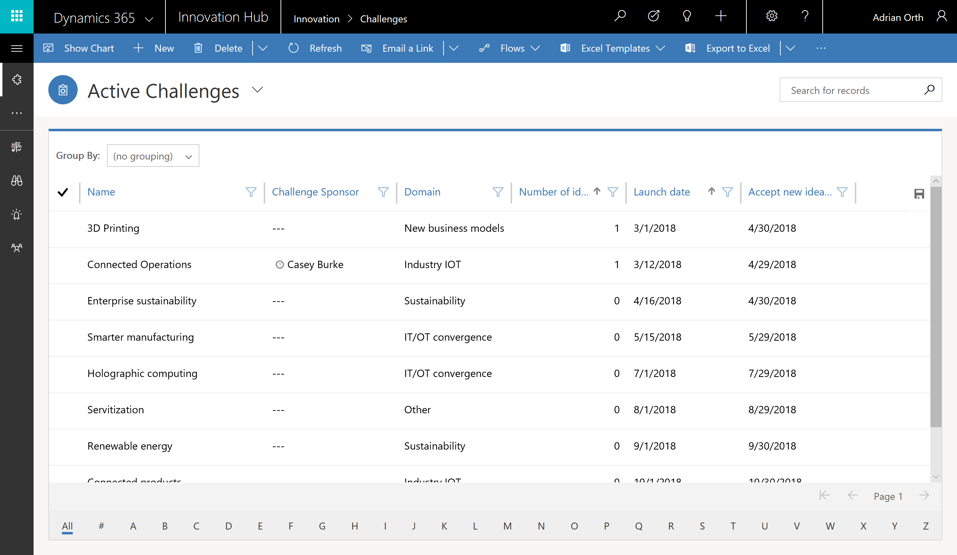
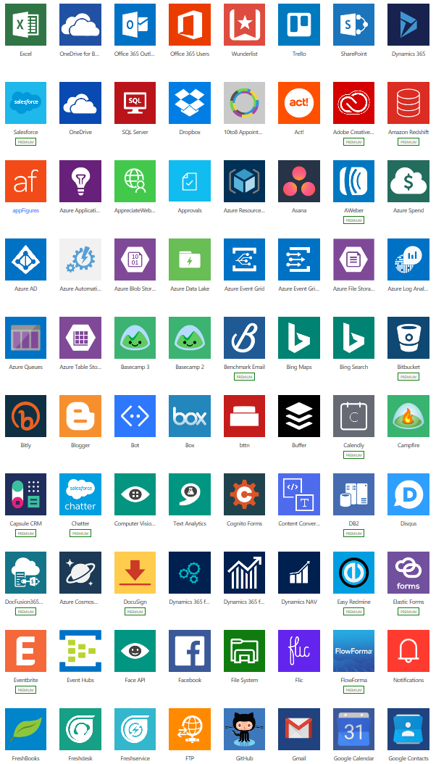
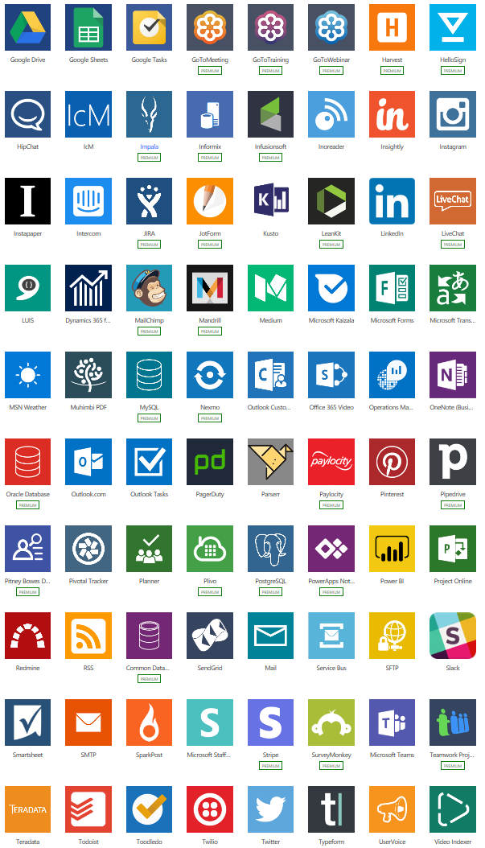
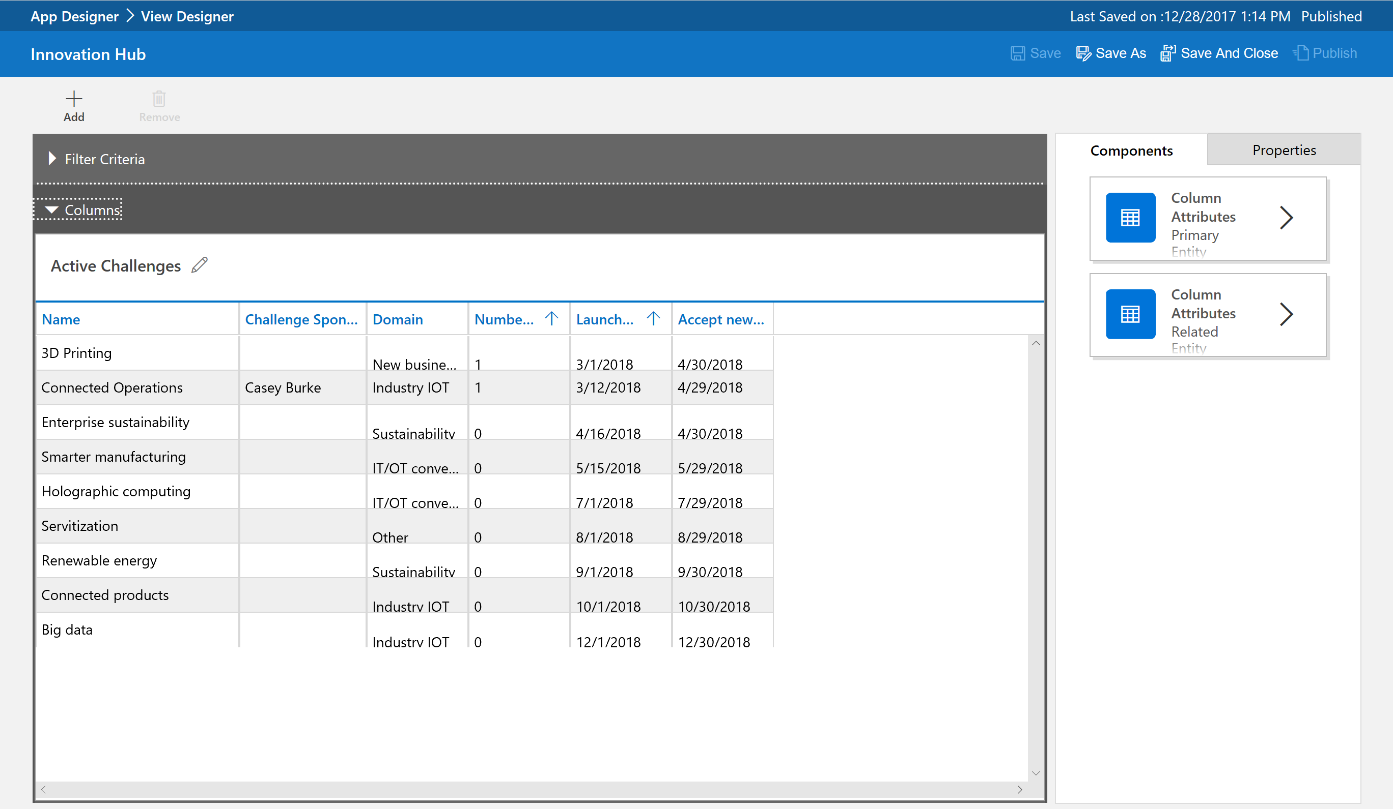
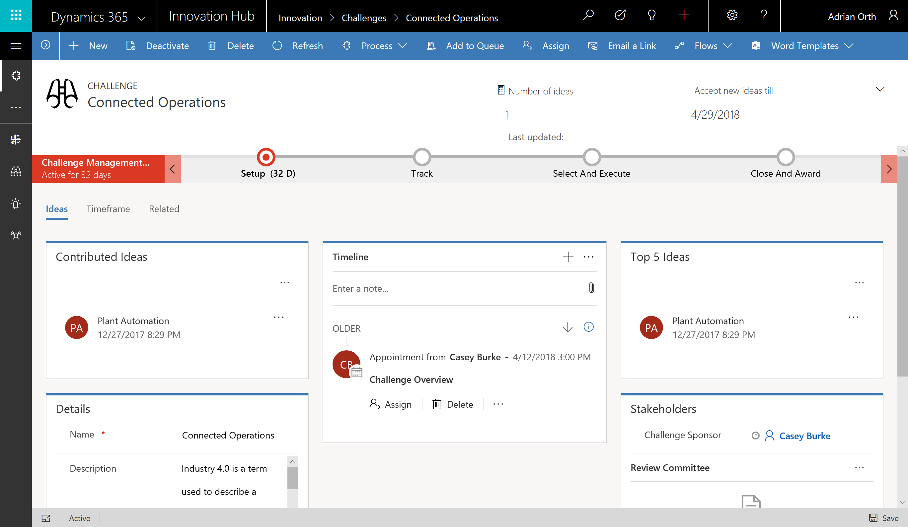
Types of Power Apps
Canvas Apps
Start with user experience in mind.
Build Pixel Perfect Apps, full control over the App Design.
Build Task-based & role-based apps.
Mash-up data from 600+ data sources.
Model-driven Apps
Built on Microsoft Dataverse.
Start with a data model, build relationships and business processes.
Build End-to-End business applications.
Build Immersive and responsive applications.
Power Apps Portals
Web based apps that allow internal and external access to view and update data within Dataverse.
Build websites with anonymous access.
Microsoft Dataverse based.

Slide 15
Canvas Apps
Canvas Apps

Slide 16
Canvas Apps help business-power-users to create and use custom business apps across platforms using Excel and PowerPoint skills.
Start with a blank screen and design your app visually by adding components to it.
When you're ready, connect it to data.
Connect to data & systems you’re already using easily
Create apps, forms, and workflows without writing code
Use apps on any device – both web and mobile

Slide 17
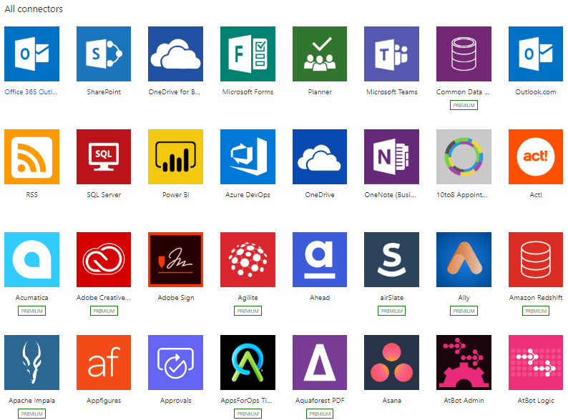
Connectors
Defines how you connect services with Microsoft Power Apps.
Over 600+ connectors available.
Connectors are classified as Standard, Premium & Preview.
Connect to on-premises systems via the Data Gateway.
Create your own - Custom Connectors.
Licensing is based on Connectors used in App.

Slide 18



Model-driven Apps
Component focused approach to App development without writing code.
Built on Microsoft Dataverse as the data model, manage relationships, and business processes, build end-to-end business applications, immersive and responsive applications.
Rich component-focused no-code design environments
Easily add Business rules and Business process flows to model your business processes
Complex responsive apps on web and mobile

Slide 19

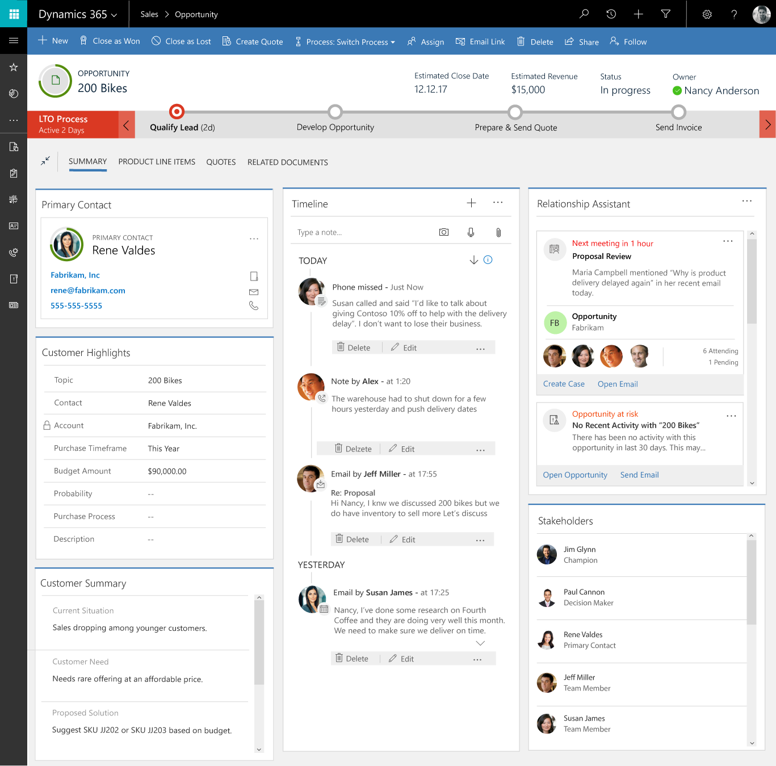
Component-focused approach to app development
Create apps around forms and processes.
Design sophisticated entity forms quickly.
Drag and drop fields and controls in a visual designer.
Forms can span multiple columns, multiple steps, and collapsible sections.
Rich, responsive client experiences.
Easily share forms, dashboards, flows, and more across multiple apps.

Slide 20
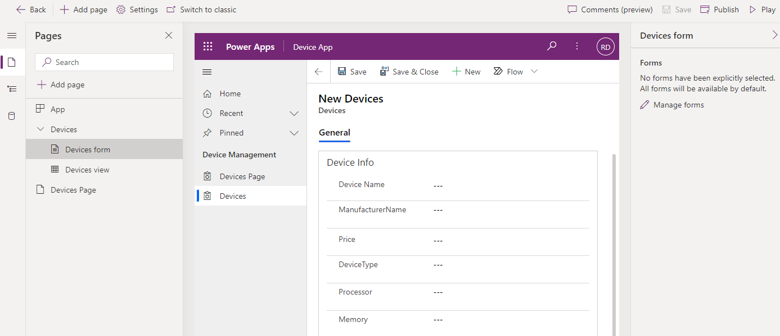
App Designer
Build Model-driven Apps with the App designer.
Add items to your app and sitemap.
Build robust, powerful grids and forms on top of Dataverse, and preview your app changes directly in the authoring experience.
Connect to multiple Dataverse Tables.
Define the App Navigation Bar.
Add Custom Pages.
Customize the Command Bar.

Slide 21

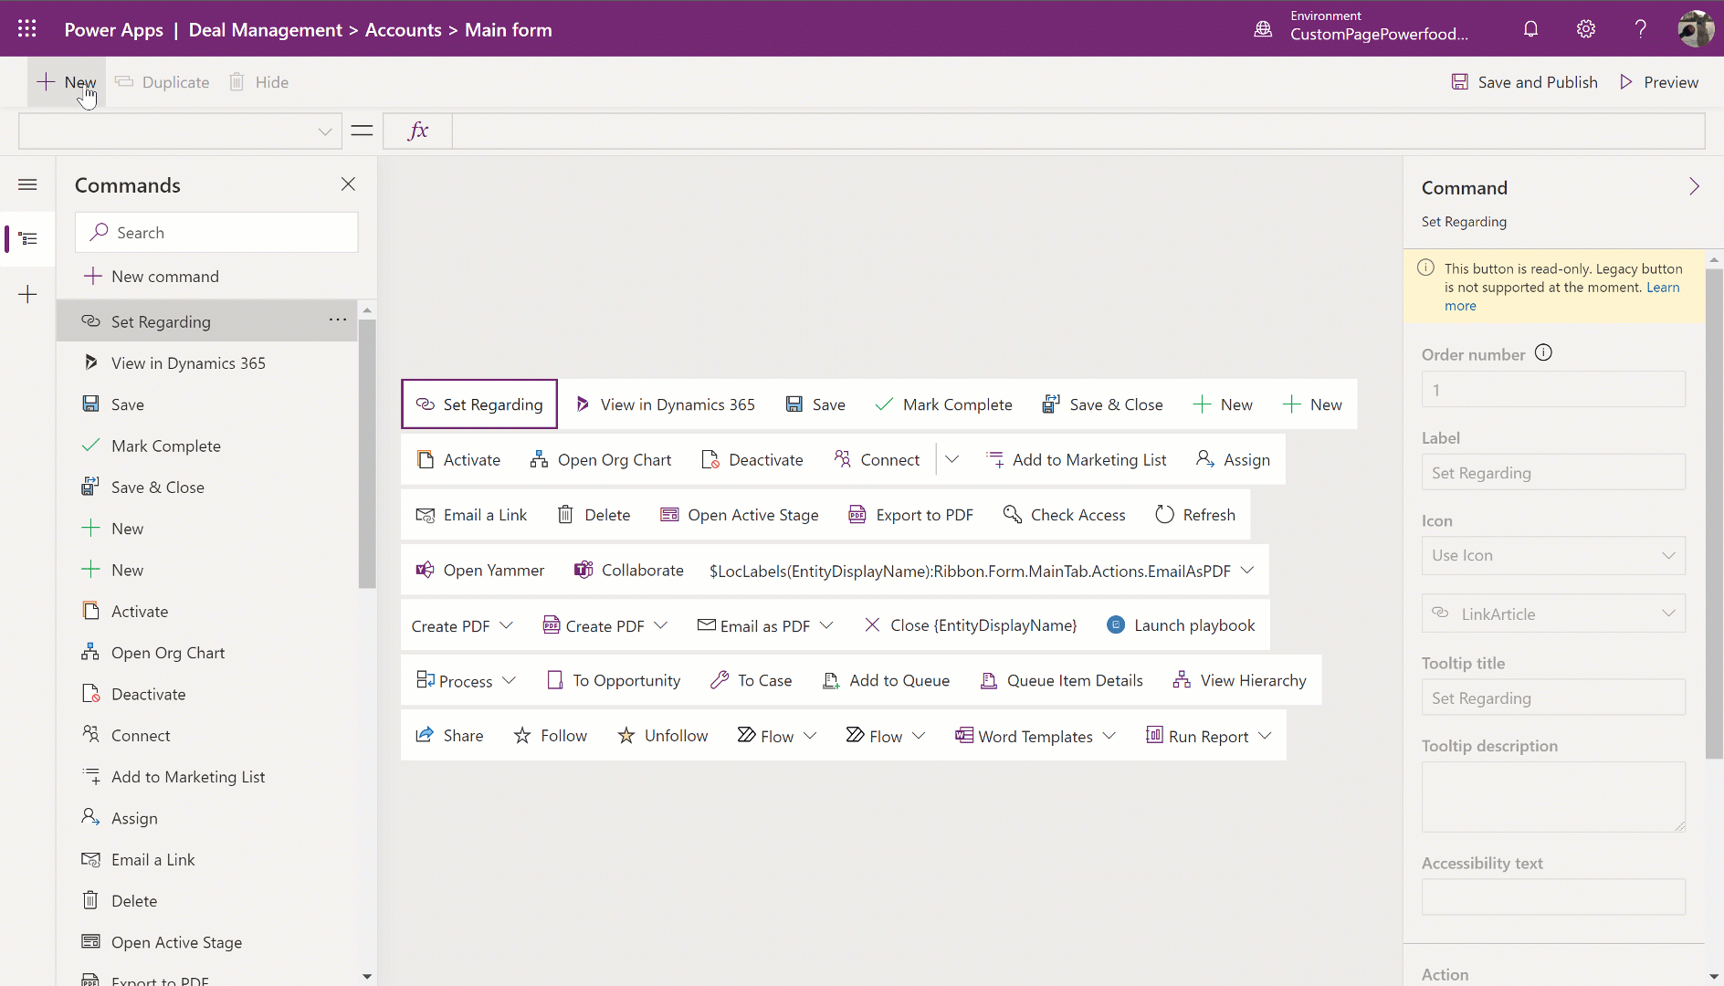
Command Designer
Customize command bars in model-driven apps without code.
Open a Custom page as a dialog.
Power Fx support for visibility and action logic.
Use JavaScript for more advanced logic.
Commands are applied to individual apps.
Classic commands remain supported, Apps can run both classic + modern commands side by side.

Slide 22
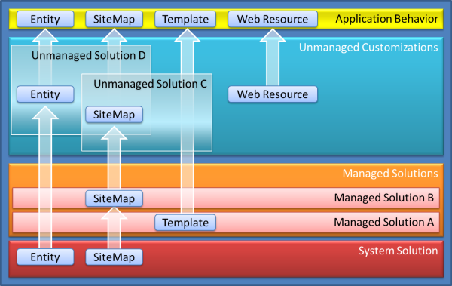
Solutions in Power Platform Container for packaging, exporting, deploying Pro Tips
Always use solutions to manage your customizations.
Keep a backup of unmanaged solutions before converting to managed.
Use Solution Layers to understand conflicts and dependencies. Types & Solution layering

Slide 23
Relationships
Link to diagram in draw.io, WhiteBoard

Slide 24
Customizations in Dataverse Solutions
Plugins
https://learn.microsoft.com/en-us/power-apps/developer/data-platform/tutorial-write-plug-in
Actions
https://learn.microsoft.com/en-us/dynamics365/customerengagement/on-premises/customize/actions?view=op-9-1
Javascript
https://learn.microsoft.com/en-us/dynamics365/customerengagement/on-premises/developer/use-javascript?view=op-9-1

Slide 25

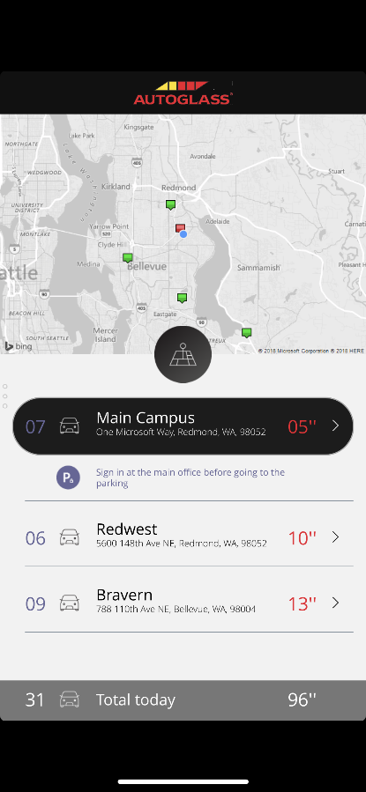
Anatomy of a Canvas app
WYSIWYG design experience
PowerPoint like pixel perfect drag and drop design experience. Start from a template, app is running with live data as you build it
Any platform support
Supports all major platforms and gives native access to device capabilities like camera, GPS, pen & ink
Data connectivity
Connect to hundreds of services and apps with built-in connectors. Over 500+ connectors available.
Share apps like documents
Share your app with 3 clicks and an email address. It’s pushed to mobile devices in seconds
Built-in data platform
Use Dataverse to store app data in a standardized Common Data Model
Seamless integration
Directly integrated with Power Automate, Power BI, Microsoft Teams, Office 365, Dynamics 365 & Azure
App logic
If you can understand formulas in Excel, you can add logic to your Power App.
Leverage AI Builder to democratize AI in your org
Extensibility model
No limits. Get a pro-dev to build you a control or connector if you need something custom

Slide 26
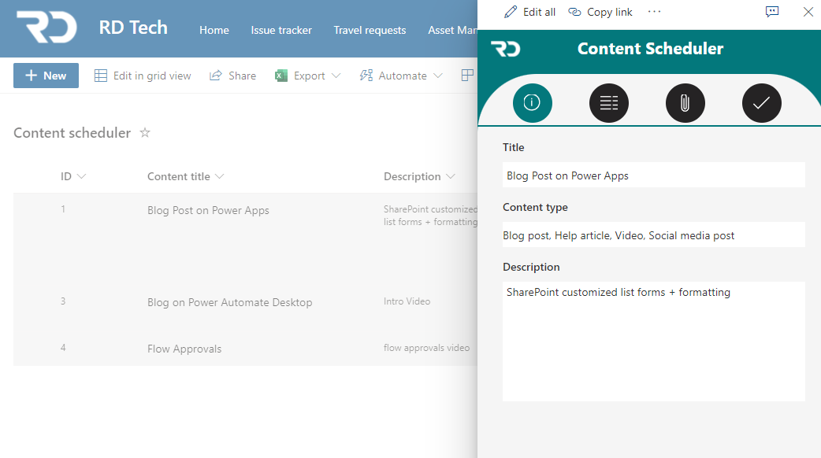
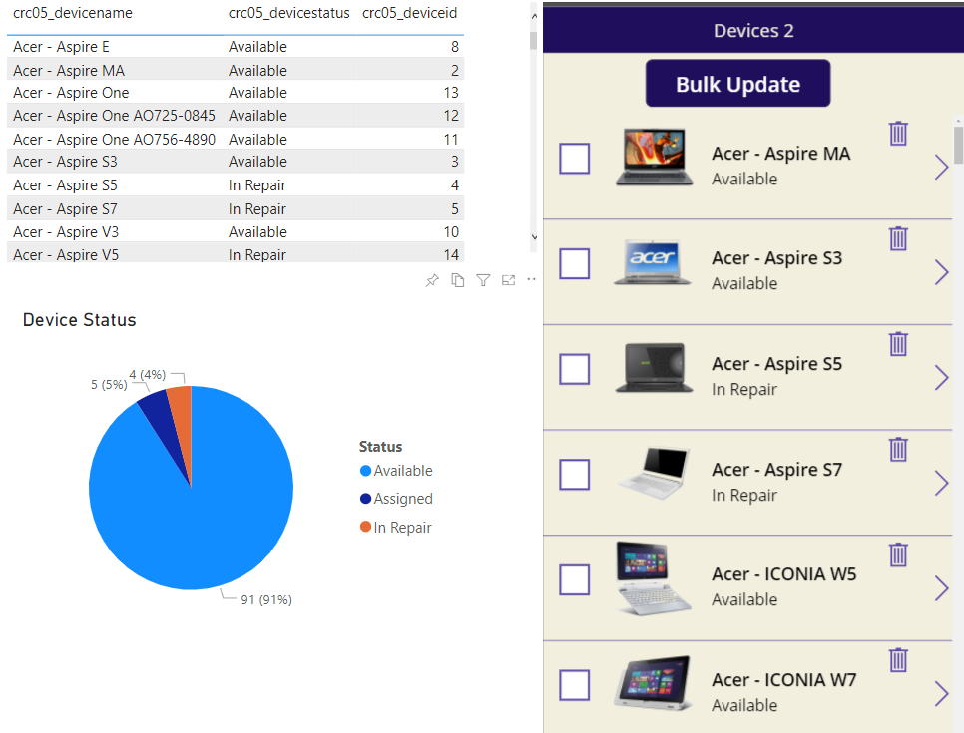

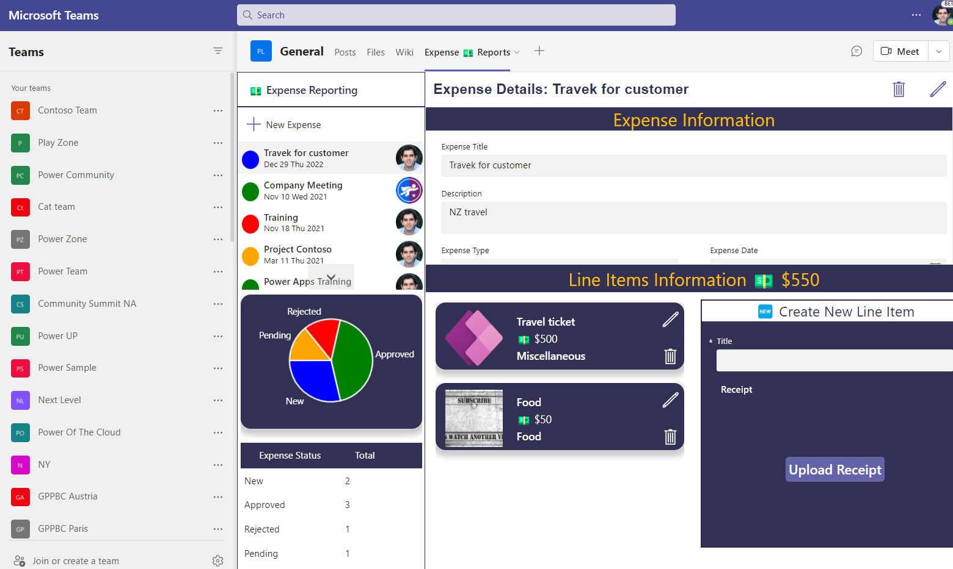


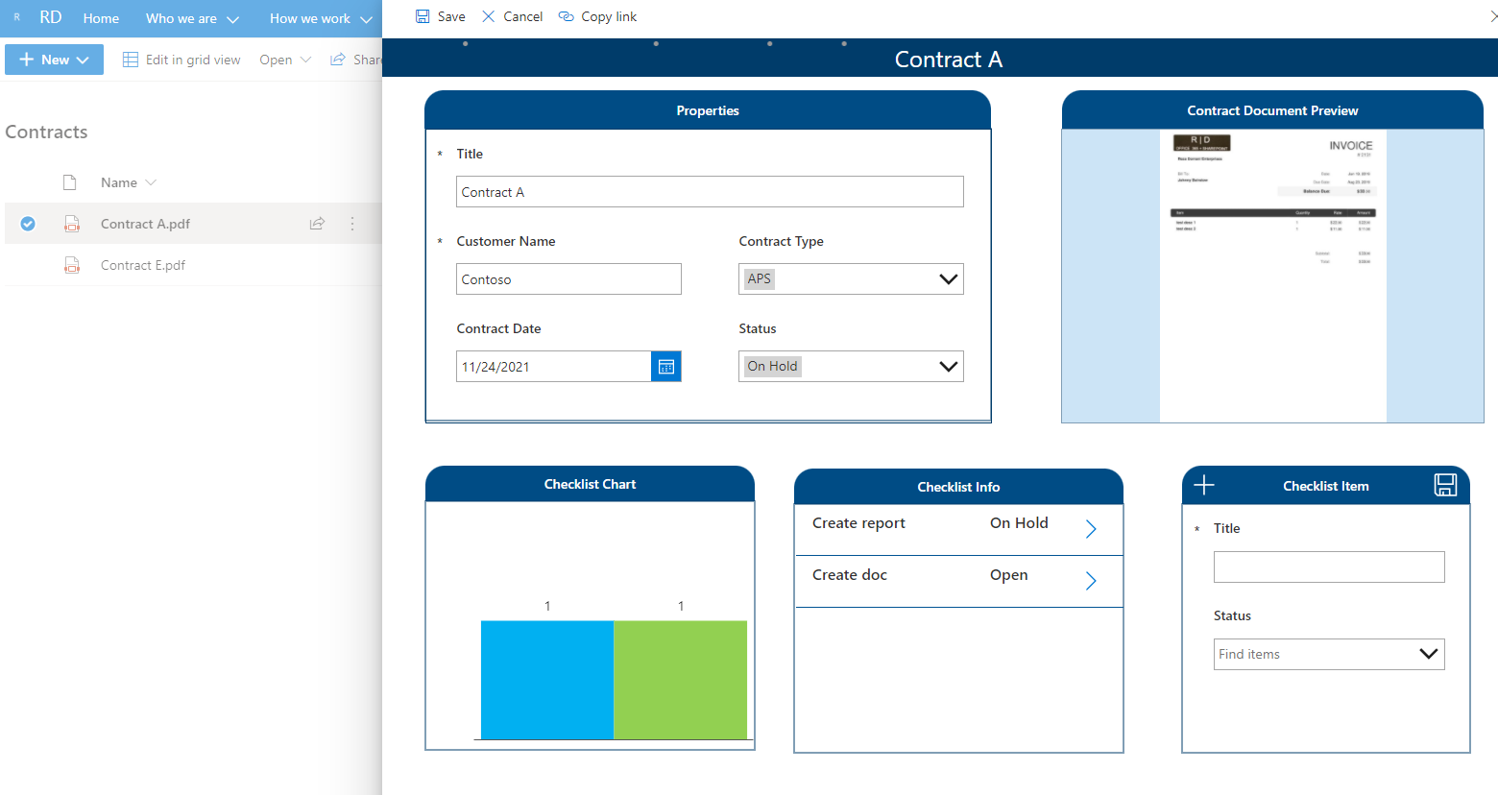
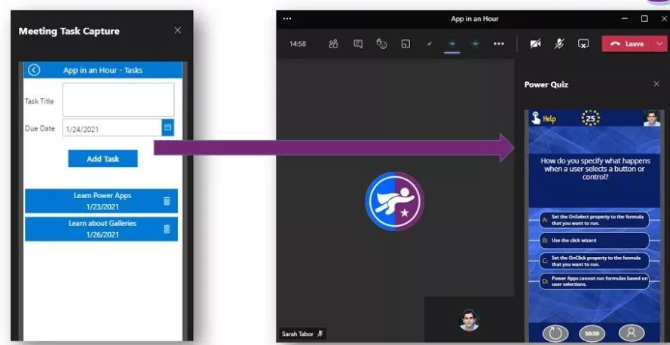
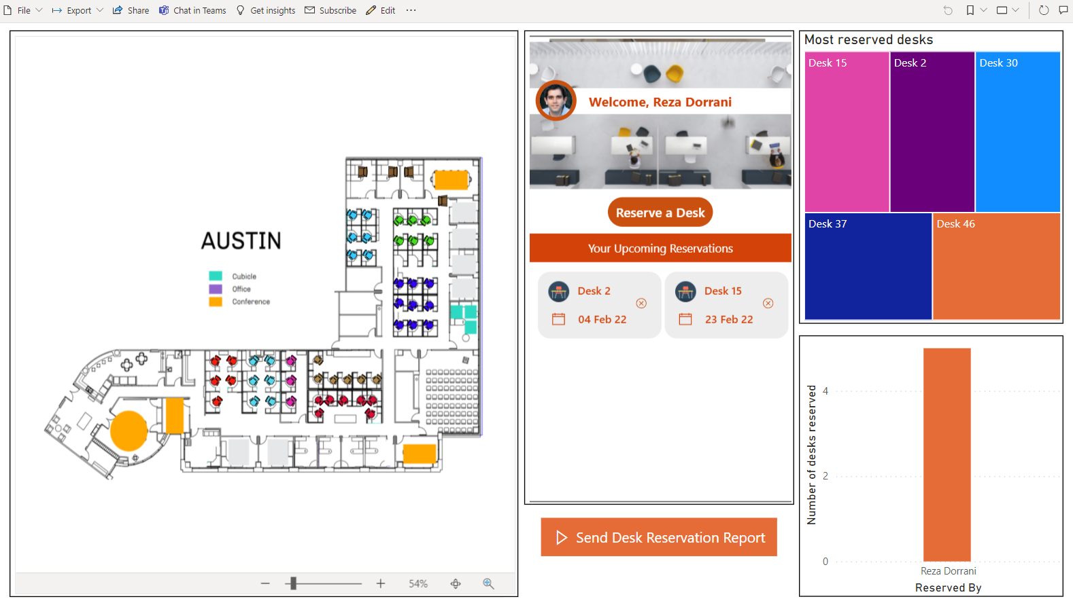
Canvas App Flavors
Standalone Canvas Apps
Power Apps Mobile App.
Build Responsive Apps using containers.
make.powerapps.com
License is based upon connectors used.
SharePoint customized list forms via Power Apps
No more InfoPath please!!!
Customize list/library forms.
Connect to other lists & data sources.
Not Responsive.
Dataverse for Teams Apps
Runs in Teams context only.
Built in Teams.
Dataverse for Teams standard feature (2GB database limit).
Build Responsive Apps using containers.
Power BI Connected Apps
App gets data from Power BI data set.
App can refresh Power BI Visuals (Direct Query)
App license needed (based on connector).

Slide 27
When to start with Canvas Apps?
Low Code (Excel & PowerPoint Skills)
Build Pixel Perfect Apps, full control over the App Design.
Build Task-based & role-based apps.
Mix & Mash-up data from 600+ data sources (integrate with data sources).
Rich integration features (SharePoint, SQL, Power Automate, Power BI, etc.)
Native Mobile Capabilities (Camera, Location etc.)
Licensing (If standard connectors are used)
Data source is not Dataverse. (If you are already invested in other data sources e.g. SharePoint, SQL)

Slide 28

Power BI
Multiple raw data sources
Excel
Dataverse
SQL Server
TXT or CSV
Odata Feed
Power BI Datasets & dataflows
Drill-down analytics to analyze data and spot trends

Slide 29
Prerequisites for working on Power BI
Power BI desktop understanding – To develop the reports
License for Power BI to publish and a workspace to share reports with other users
Data Analysis, Data Modelling Skill
Business Understanding

Slide 30
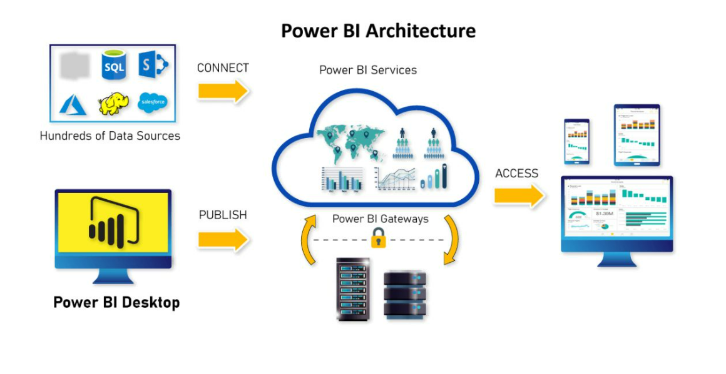
Components
Power BI Reports
Power BI Dashboards
Semantic Model
Power BI Dataflows
Power BI Report Server

Slide 31
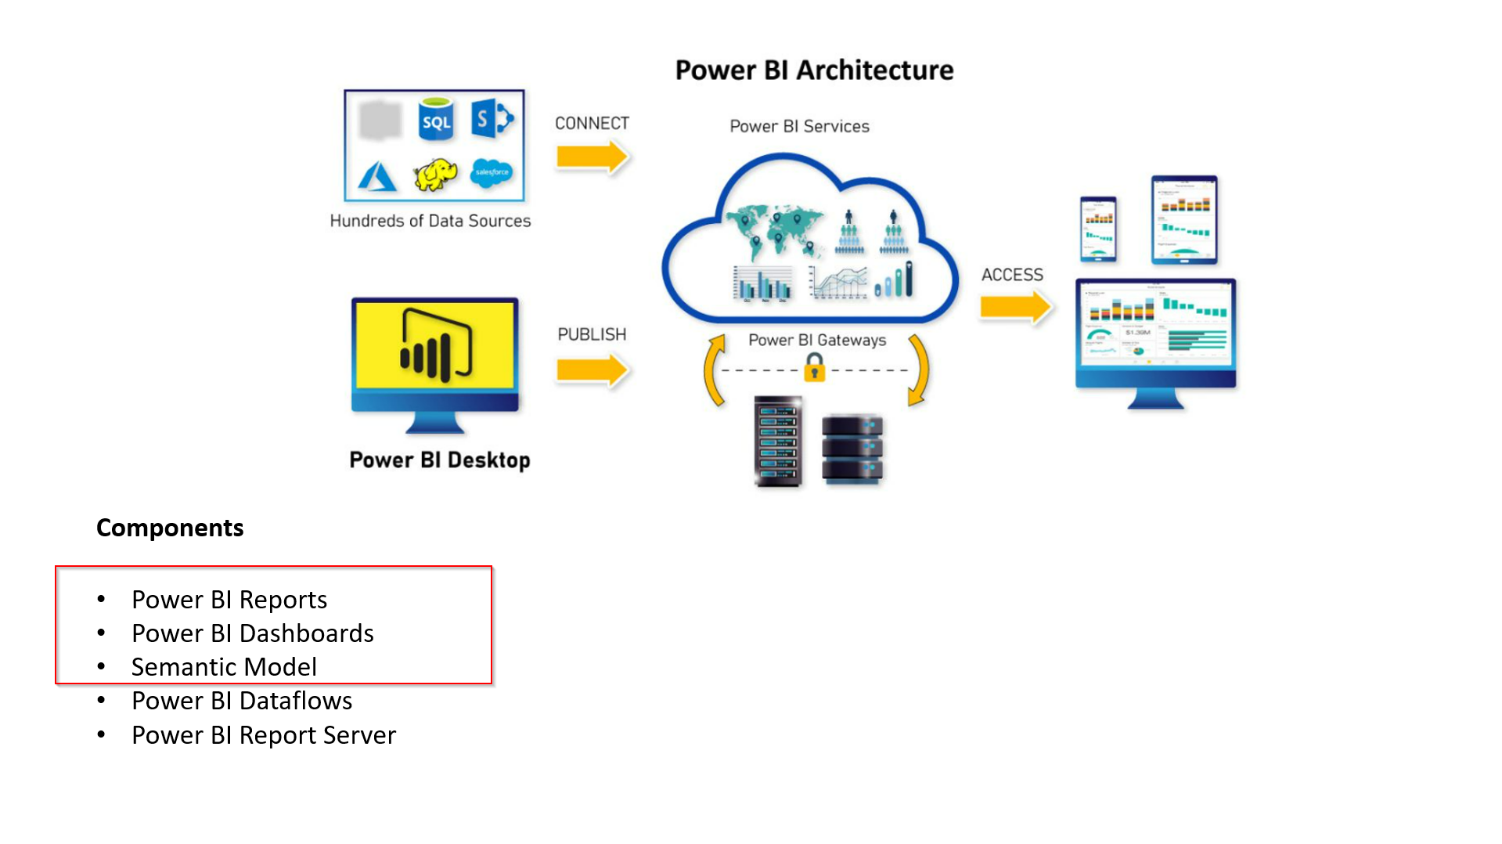


Slide 32
Installing Power BI Desktop
Developing Reports
Two ways to get it
Download the Power BI Desktop exe file
Download from Microsoft Store – Preferred

Slide 33
Steps involved in creating Power BI Reports/Dashboards
Getting Data from data source
Cleaning the Data
Model the data
Visualize the Data
Publish the Report to Power BI Service
Sharing the Report
Create dashboards by pining the visuals

Slide 34
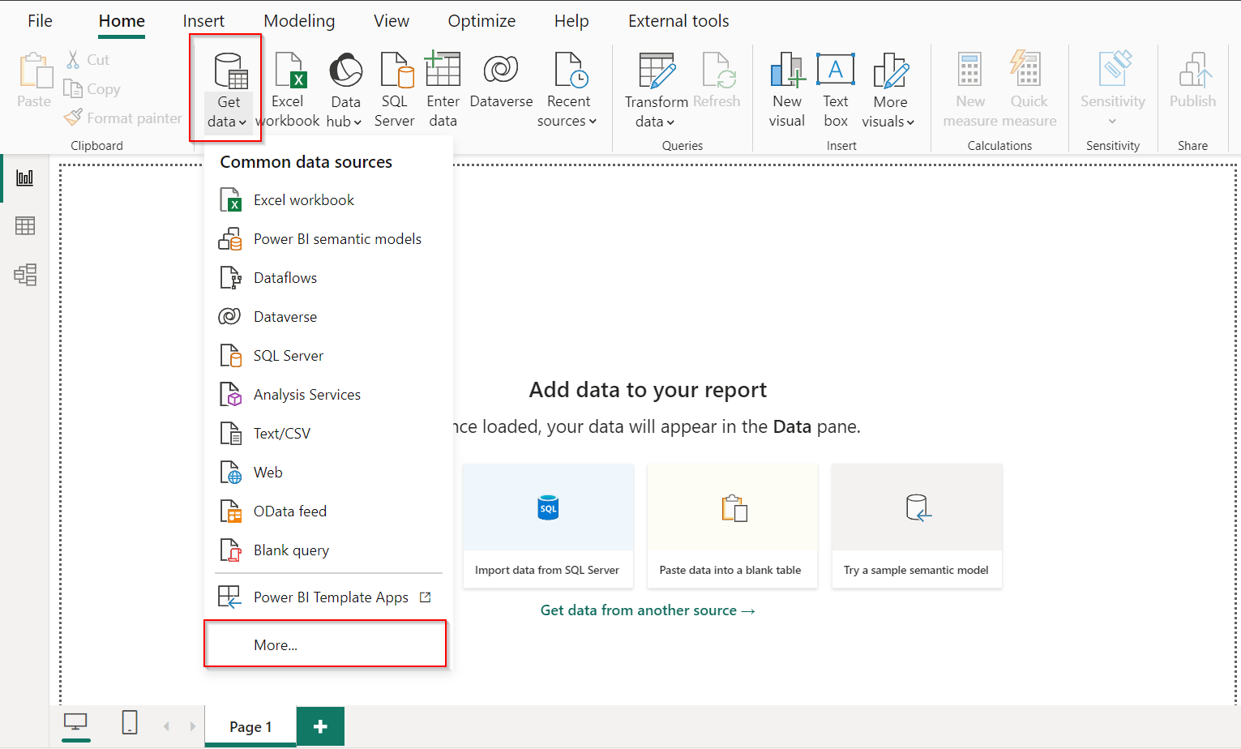
Connecting Data source
Ways to connect to the different connectors available in Power BI
There are 120 + data sources available from which you can choose from

Slide 35
Choosing import modes
Import Mode
Direct Query
Data is imported into Power BI and preferred mode in most scenarios
Stores a snapshot of data in the report, which can be refreshed at scheduled intervals.
Data is the source is not modified with any ETL operations
Faster performance as it used Vertipaq storage engines
Do note the data volume limitations for import
Allows users to directly query data from a connected data source
It is best suited for Real Time Analytics
Data in the source is modified with any ETL operations
Slower performance when compared and mainly depends on the underlying data source
A limit of 1 million rows can be returned in any query
Live Connection connects to the reports using Semantic Model
Lastly choosing import mode may depend on business needs and you can combine both making Dual Mode

Slide 36
Data preparation and modelling
Once data is loaded in to PBI, necessary ETL transformations are performed using Power Query
Create relationships between tables
Star Schema design principle
Creating Measures
Calculated Column
Calculated table

Slide 37
Understanding the Relationships
Relationships play a crucial role in any model design
Power BI attempts to identify the relationships when data is loaded
Relationships can be manged from Manage Relationships in Power BI Desktop
Cardinality and cross filter direction play an important role in filtering your dataset.

Slide 38
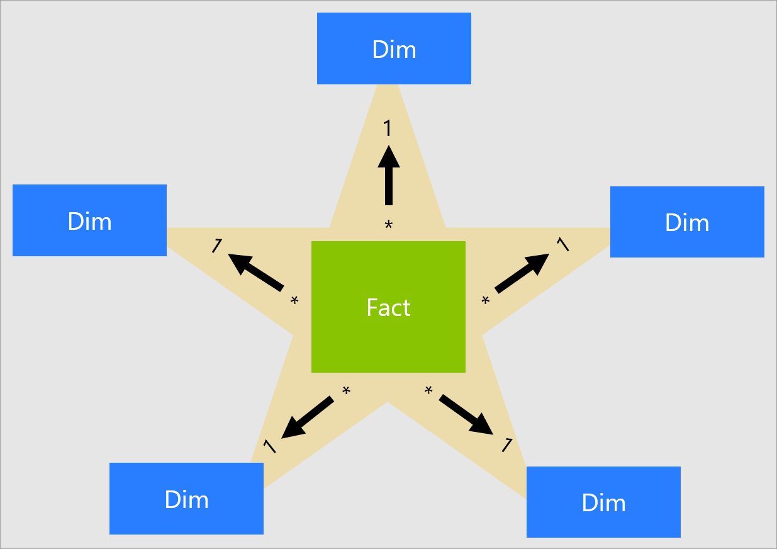
Star Schema Design
Star schema requires model tables to be classified as Fact and Dimension tables
It is only determined by the Relationships
1. Dimension tables support filtering and grouping
2. Fact tables support summarization
Star Schema Models are optimized for performance and usability

Slide 39
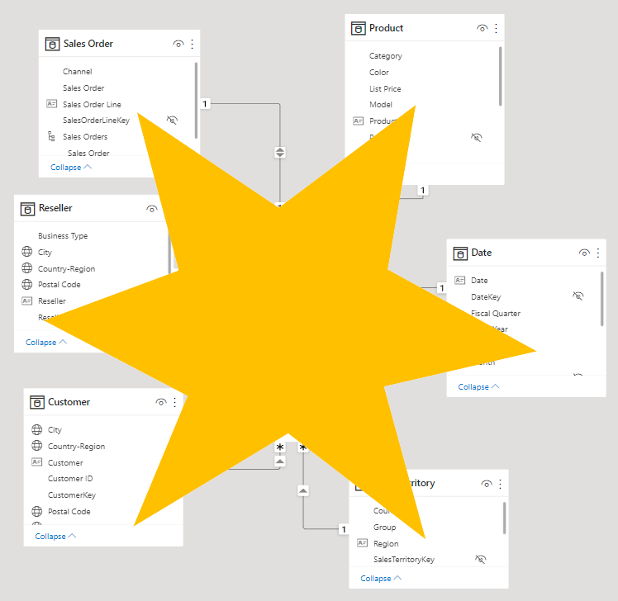
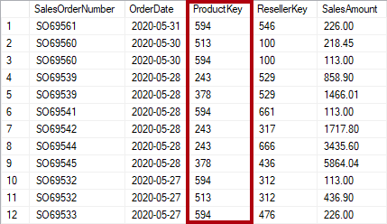
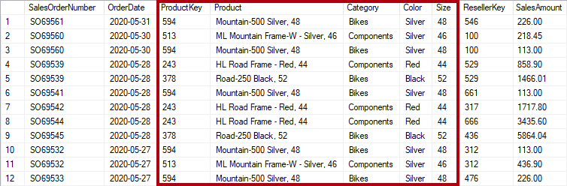
Normalization
Denormalization

Slide 40
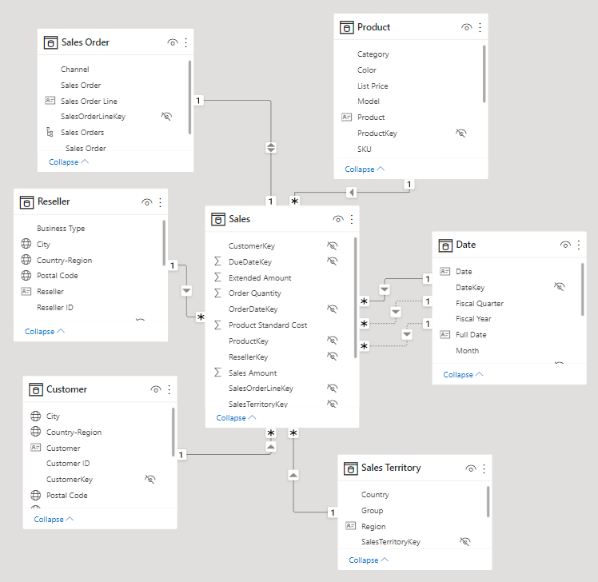
Modelling for high performance scenarios
Model should consists of Fact and Dimension tables
Remove Unnecessary Columns
Remove Unnecessary Rows
Disable Auto Date Time
Disable Power Query Load

Slide 41
Modelling continued..
DAX(Data Analysis Expressions)
Blue Revenue =
CALCULATE(
SUM(Sales[Sales Amount]),
'Product'[Color] = "Blue"
)
Syntax
Functions
Context
1. Row Context - Calculated Column – Precomputed and stored in the model
2. Filter Context – Measure – Not precomputed and stored in the model
Formulate your DAX code using DAX Guide(https://dax.guide/generate/)
Debug your DAX code in DAX Studio(https://daxstudio.org/)
Using Power Query for any ETL transformations on source data
Understanding difference between M Query and DAX

Slide 42
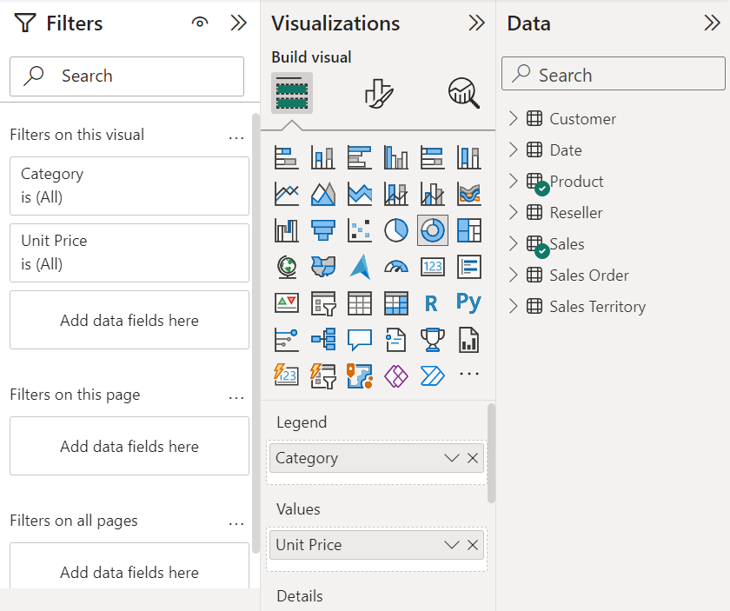
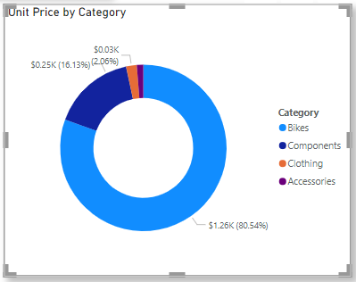
Creating visualizations
Select the required visualization as per your requirement
Drag the data fields on to the visual

Slide 43
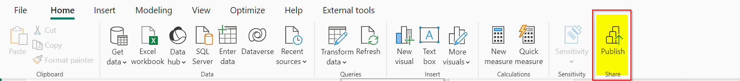
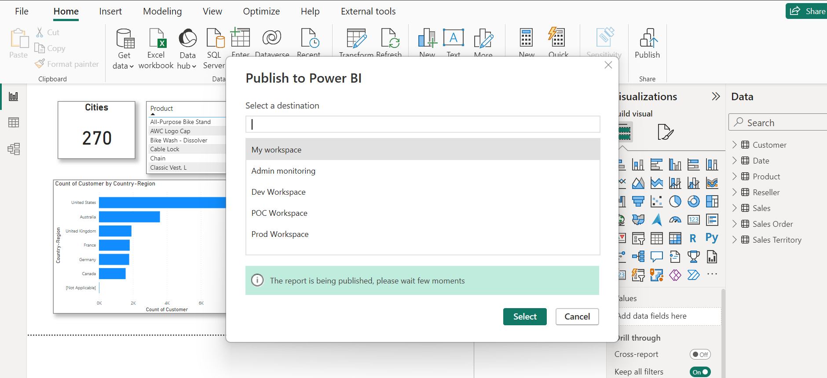
Publish to Power BI Service
Setting up workspaces to manage different environments
One click publish to Power BI Workspace
Set up Refresh frequency in Power BI Service

Slide 44
Tools to use for development
DAX Studio https://daxstudio.org/downloads/ - Best tool to use
DAX Formatter https://www.daxformatter.com/ - formats DAX code
DAX Guide https://dax.guide/
Power BI Helper https://powerbihelper.org/ - tool to create documentation for the Power BI
ALM Tool Kit (http://alm-toolkit.com/)- manages the application life cycle of models
Bravo (https://www.sqlbi.com/tools/bravo-for-power-bi/) – used for simple Power BI Tasks

Slide 45
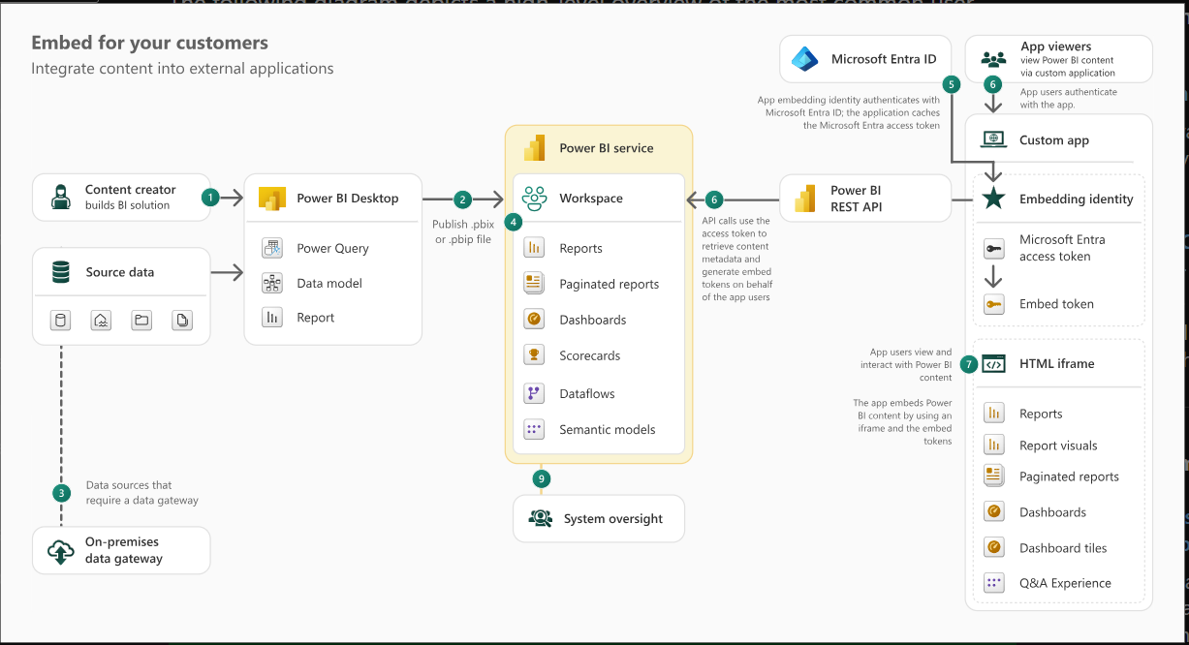
Understanding Power BI Embedded
Check out Power BI Embedded Analytics Playground https://playground.powerbi.com/en-us/

Slide 46
Integration and extensibility with Power Apps
Model Driven Apps
a. Power BI Embed Reports with Environment variables
b. Embed Power BI Report in Model driven App forms
2. Canvas Apps
a. Insert Custom Power BI Tiles and Power BI Report
b. Power Apps visual for Power BI

Slide 47
Options in Power BI Security in Power BI
In Power BI Desktop
Data Load
Authentication in Browser
In Power BI Service
Manage access to workspace
Sharing the Power BI Reports/Dashboards
In Admin Centre
Tenant Settings
Custom branding
Usage Metrics
Organization Visuals
Connecting to Azure
Row Level Security – Applies for Viewers only
Object Level Security – Secure specific tables or columns for certain viewers
Licensing in Power BI
Free
Power BI Pro
Power BI Premium Per User
Power BI Premium(P SKU)
Power BI Embedded(A SKU)

Slide 48
Power Automate
Automate manual tasks
Connect to multiple systems
No-code can get you started, but you’ll likely need a developer to help with more complicated flows and writing expressions

Slide 49
Types of Power Automate Flows
Automated Flow
Instant Flow
Scheduled Flow
Business Process Flow
Key Concepts
Trigger
Action
Condition

Slide 50

Features of Power Automate
Core Features of Power Automate
Prebuilt Templates: Ready-to-use templates for popular workflows.
Connectors: Predefined connectors that allow you to integrate with hundreds of services (e.g., SharePoint, Outlook, Twitter, SQL Server, and third-party APIs).
Custom Connectors: Create your own connectors to link with apps not in the predefined list.
Expression Editor: Allows for advanced logic in flows, using formulas and expressions (e.g., formatting dates, manipulating text).

Slide 51

Copilot Studio
Benefits of using Copilot:
Natural Language Input: Users can describe what they want to achieve using simple language, and Copilot Studio generates the corresponding automation or app logic.
Embedded in Power Apps & Power Automate: Direct integration into both Power Apps and Power Automate, streamlining the app-building and automation processes.
Predictive Suggestions: AI suggests actions, components, and templates based on user inputs, helping to quickly build solutions.
Real-Time Collaboration: Copilot assists in creating apps and flows collaboratively in real time.
Purposes of using Copilot Studio
Build chatbots using no-code!
Select from a list of supported languages
Let users have conversations and take action (when you combine Copilot Studio & Power Automate!)

Slide 52


Slide 53
DEMO!
Notes:
Sales Trial
Accounts
Contacts
Create Opportunity
Add Products
Convert to Quote
Convert to Order

Slide 54
Resources
https://github.com/pavanmanideep/PL-400-Training-Microsoft-Power-Platform-Developer
https://github.com/pavanmanideep/Power-Platform-Fusion-Development
https://github.com/pavanmanideep/PowerPlatformLearnings
https://github.com/pavanmanideep/Power-Platform-Boot-Camps

Slide 55

Any Questions?

Slide 56
Thank you!

